Slide 1
Goldman Sachs Consumer Finance Data Analysis
SQL Capstone Project — Risk Assessment & Portfolio Health
An end-to-end audit of a large-scale consumer loan dataset to uncover regional growth trends, default risks, and financial performance using Advanced SQL.
Scope
Methods
Focus
Large-scale consumer loan dataset analysis
Advanced SQL techniques & data auditing
Regional trends, default risk & portfolio health
Presented by Mohit Kumar · Data Analyst

Slide 2
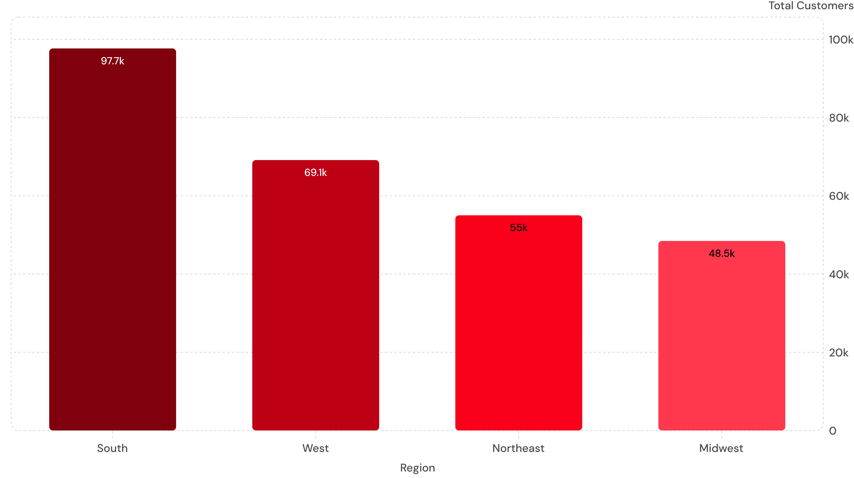
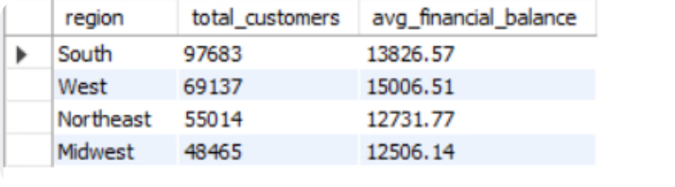
Regional Customer Analysis
QUESTION 1
SQL Query
SELECT
sr.region,
COUNT(DISTINCT c.customer_id) AS total_customers,
ROUND(AVG(c.avg_cur_bal), 2) AS avg_financial_balance
FROM customer c
LEFT JOIN state_region sr
ON c.addr_state = sr.state
WHERE sr.region IS NOT NULL
GROUP BY sr.region
ORDER BY total_customers DESC;
SQL Output
Key Takeaway: The South region leads with 97,683 customers — reflecting stronger lending demand and deeper market penetration. The West commands the highest average balance at $15,006.51, suggesting wealthier borrower profiles despite lower headcount.

Slide 3
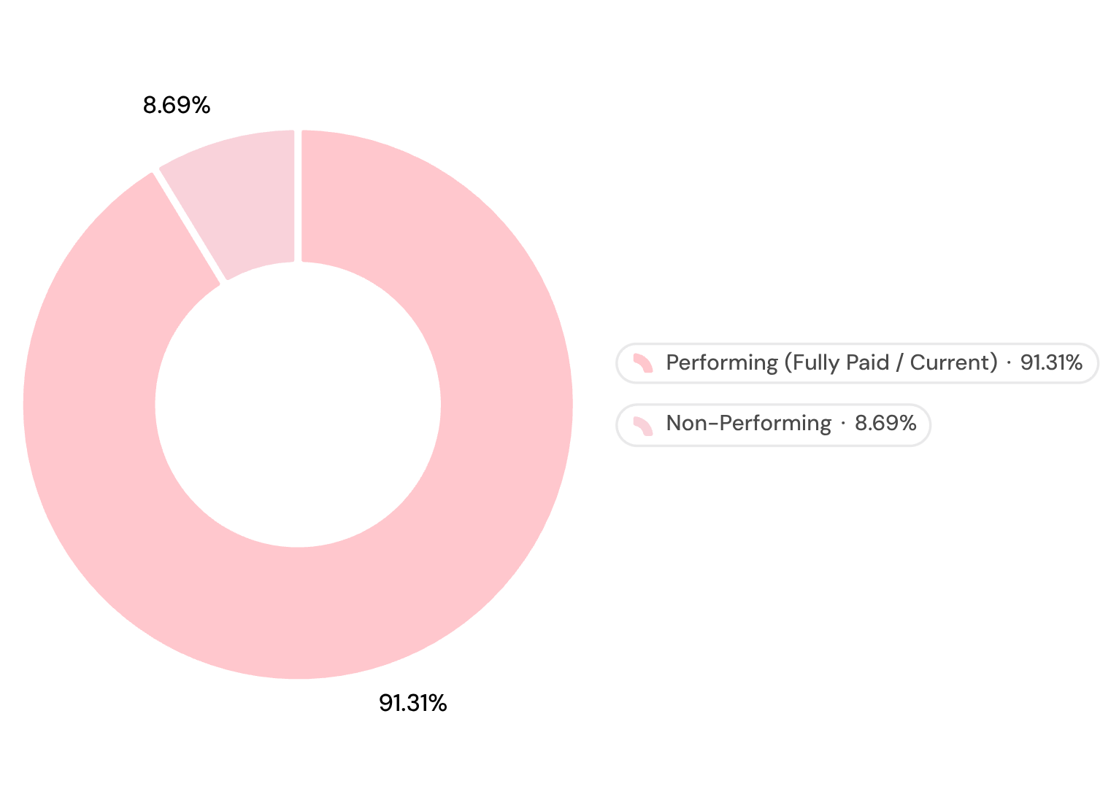
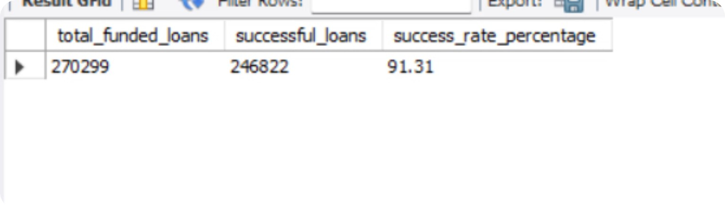

Loan Approval Efficiency
QUESTION 2
SQL Query
Portfolio Performance — Performing vs. Non-Performing
SELECT
COUNT(loan_id) AS total_funded_loans,
SUM(CASE WHEN loan_status IN ('Fully Paid', 'Current') THEN 1 ELSE 0 END) AS successful_loans,
ROUND(
SUM(CASE WHEN loan_status IN ('Fully Paid', 'Current') THEN 1 ELSE 0 END) * 100.0 / COUNT(loan_id),
2
) AS success_rate_percentage
FROM loan;
Query Output
270K
246K
Total Funded Loans
Successful Loans
91.31%
Success Rate
Key Takeaway: With a 91.31% success rate across 270K+ loans, the portfolio demonstrates strong repayment discipline and limited default exposure — a foundational metric for credit health benchmarking.

Slide 4
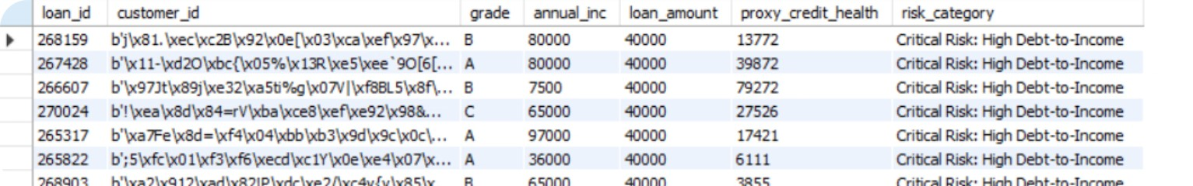
High Default Risk Identification
QUESTION 3
SQL Query
Risk Classification Framework
SELECT
l.loan_id,
c.customer_id,
l.grade,
c.annual_inc,
l.loan_amount,
c.avg_cur_bal AS proxy_credit_health,
CASE
WHEN l.loan_amount > (c.annual_inc * 0.4) THEN 'Critical Risk: High Debt-to-Income'
WHEN c.avg_cur_bal < 3000 AND l.loan_amount > 20000 THEN 'High Risk: Over-leveraged'
WHEN l.grade IN ('E', 'F', 'G') THEN 'High Risk: Poor Bank Grade'
ELSE 'Monitor'
END AS risk_category
FROM loan l
JOIN customer c ON l.customer_id = c.customer_id
WHERE
(l.loan_amount > 20000 AND c.annual_inc < 45000 AND c.avg_cur_bal < 3000)
OR l.loan_amount > (c.annual_inc * 0.4)
ORDER BY l.loan_amount DESC;
🔴 Critical Risk: High Debt-to-Income
Loan amount exceeds 40% of annual income. Borrowers at this threshold show significantly elevated default probability and require immediate underwriting review.
🟠 High Risk: Over-Leveraged
Loan amounts >$20K combined with avg balance <$3K and annual income <$45K indicate an unsustainable debt burden with minimal liquidity buffer.
🟡 High Risk: Poor Bank Grade
Credit grades E, F, G correlate with elevated historical default rates. Grade-based segmentation enables tiered monitoring and early intervention triggers.
Key Takeaway: Weak credit quality combined with high loan exposure significantly increases default probability. Proactive monitoring across all three risk tiers is essential for portfolio protection.

Slide 5
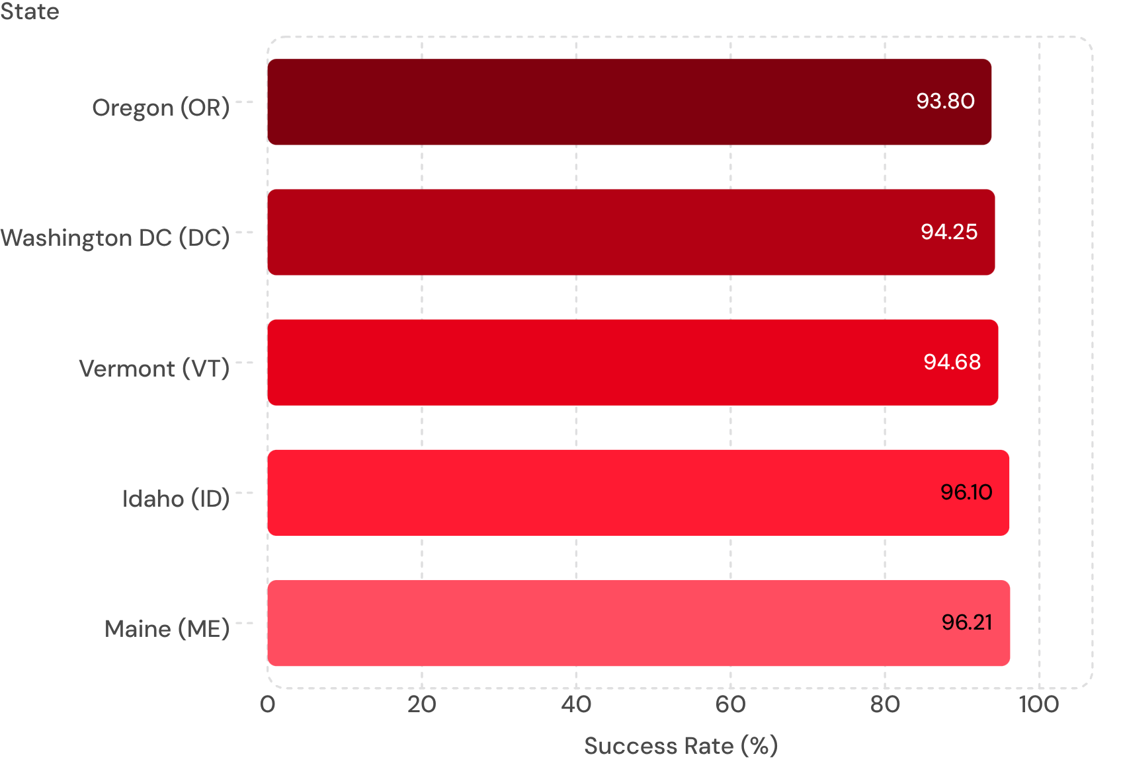
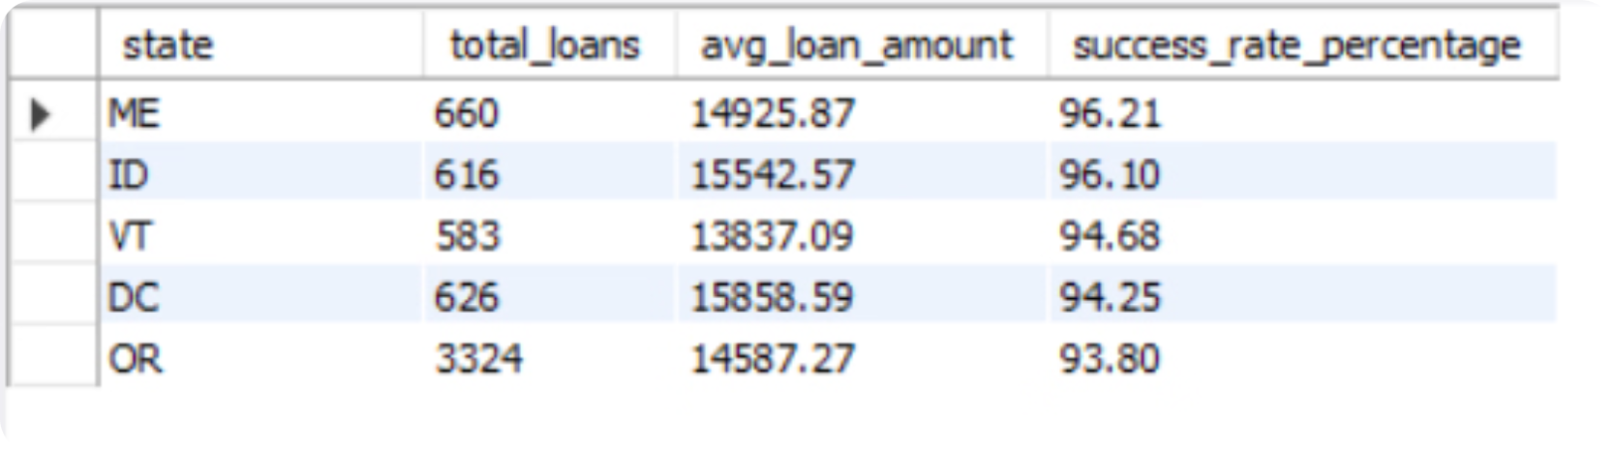
Top 5 States by Loan Success Rate
QUESTION 4
SQL Query
Success Rate by State (Top 5)
SELECT
state,
COUNT(loan_id) AS total_loans,
ROUND(AVG(loan_amount), 2) AS avg_loan_amount,
ROUND(SUM(CASE WHEN loan_status IN ('Fully Paid', 'Current') THEN 1 ELSE 0 END) * 100.0 / COUNT(loan_id), 2) AS success_rate_percentage
FROM loan
GROUP BY state
HAVING total_loans > 500 -- Filters out states with too little data to avoid fake 100% rates
ORDER BY success_rate_percentage DESC
LIMIT 5;
Key Takeaway: Maine (96.21%) and Idaho (96.10%) lead all states with >500 loans — regional policy environment and borrower demographic profiles appear to be the primary performance drivers.

Slide 6
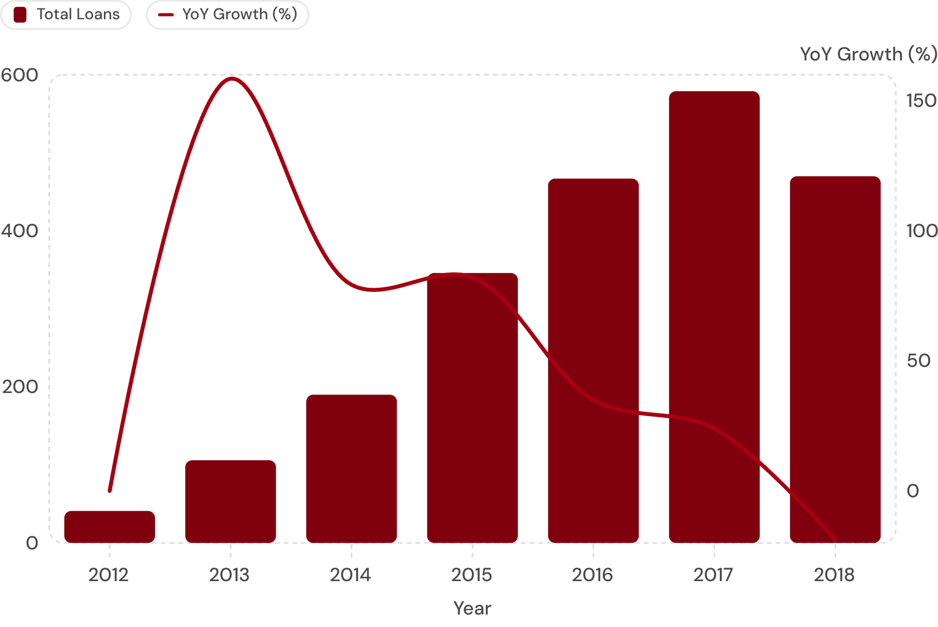
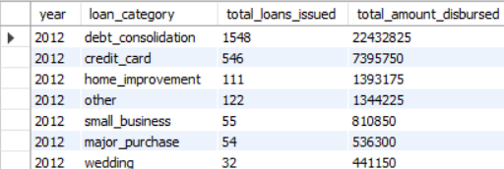

Yearly Loan Growth Trends — Car Loans
QUESTION 5
SQL Query (CTE with LAG Window Function)
Car Loan Volume & YoY Growth (2012–2018)
WITH Yearly_Trends AS (
SELECT
CAST(issue_year AS UNSIGNED)
AS issue_year,
purpose,
COUNT(loan_id) AS total_loans
FROM loan
WHERE issue_year IS NOT NULL
AND purpose = 'car'
GROUP BY issue_year, purpose
)
SELECT issue_year, purpose,
total_loans,
LAG(total_loans) OVER (
PARTITION BY purpose
ORDER BY issue_year)
AS prev_year_loans,
ROUND((total_loans -
LAG(total_loans) OVER (
PARTITION BY purpose
ORDER BY issue_year))
* 100.0 / LAG(total_loans) OVER (
PARTITION BY purpose
ORDER BY issue_year), 2)
AS growth_percentage
FROM Yearly_Trends
ORDER BY issue_year ASC;
Key Takeaway: Car loans surged +158.54% YoY in 2013, sustaining double-digit growth through 2017 before a -18.83% contraction in 2018 — signaling a market saturation inflection point worth monitoring in origination strategy.

Slide 7
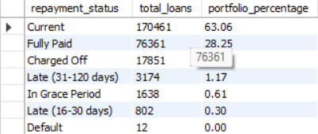

QUESTION 6
Average Loans Per Customer & Repayment History
SQL Query
Query Output
SELECT COUNT(loan_id) AS total_loans_issued, COUNT(DISTINCT customer_id) AS total_unique_customers, ROUND(COUNT(loan_id) * 1.0 / COUNT(DISTINCT customer_id), 2) AS avg_loans_per_customer FROM loan;
SELECT loan_status AS repayment_status, COUNT(loan_id) AS total_loans, ROUND(COUNT(loan_id) * 100.0 / (SELECT COUNT(*) FROM loan), 2) AS portfolio_percentage FROM loan GROUP BY loan_status ORDER BY total_loans DESC;
Repayment Status | Total Loans | Portfolio %
Current | 170,461 | 63.06%
Fully Paid | 76,361 | 28.25%
Charged Off | 17,851 | 6.60%
Late (31-120 days) | 3,174 | 1.17%
In Grace Period | 1,638 | 0.61%
Late (16-30 days) | 802 | 0.30%
Default | 12 | 0.00%
Total Loans Issued: 270,299
Total Unique Customers: 225,000 (approx)
Avg Loans Per Customer: 1.20

Slide 8
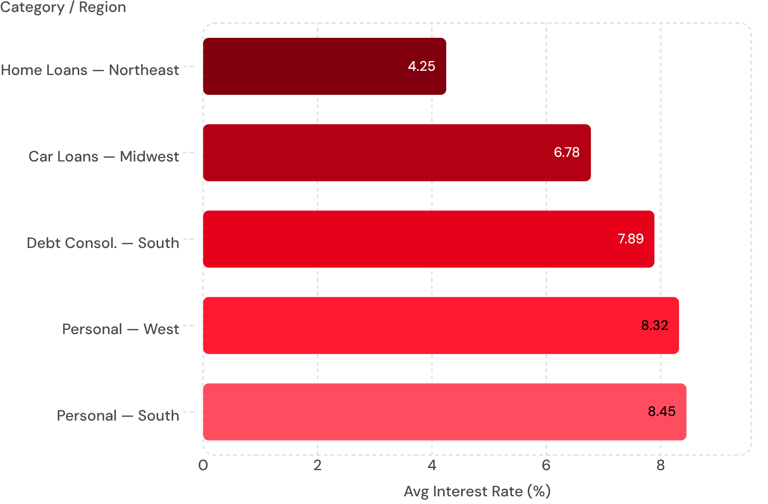
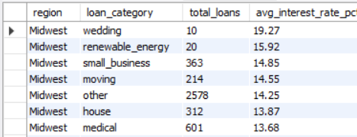
Average Interest Rate by Category & Region
QUESTION 7
SQL Query
Avg Interest Rate by Loan Category & Region
SELECT
sr.region,
l.purpose AS loan_category,
COUNT(l.loan_id) AS total_loans,
ROUND(AVG(l.int_rate * 100), 2) AS avg_interest_rate_pct
FROM loan l
LEFT JOIN state_region sr
ON l.state = sr.state
WHERE sr.region IS NOT NULL
GROUP BY sr.region, l.purpose
ORDER BY sr.region ASC, avg_interest_rate_pct DESC;
Highest Risk
Lowest Risk
Personal loans carry 8.45% avg rate, reflecting short-term unsecured exposure
Home loans at 4.25% — collateral-backed structures reduce lender exposure

Slide 9
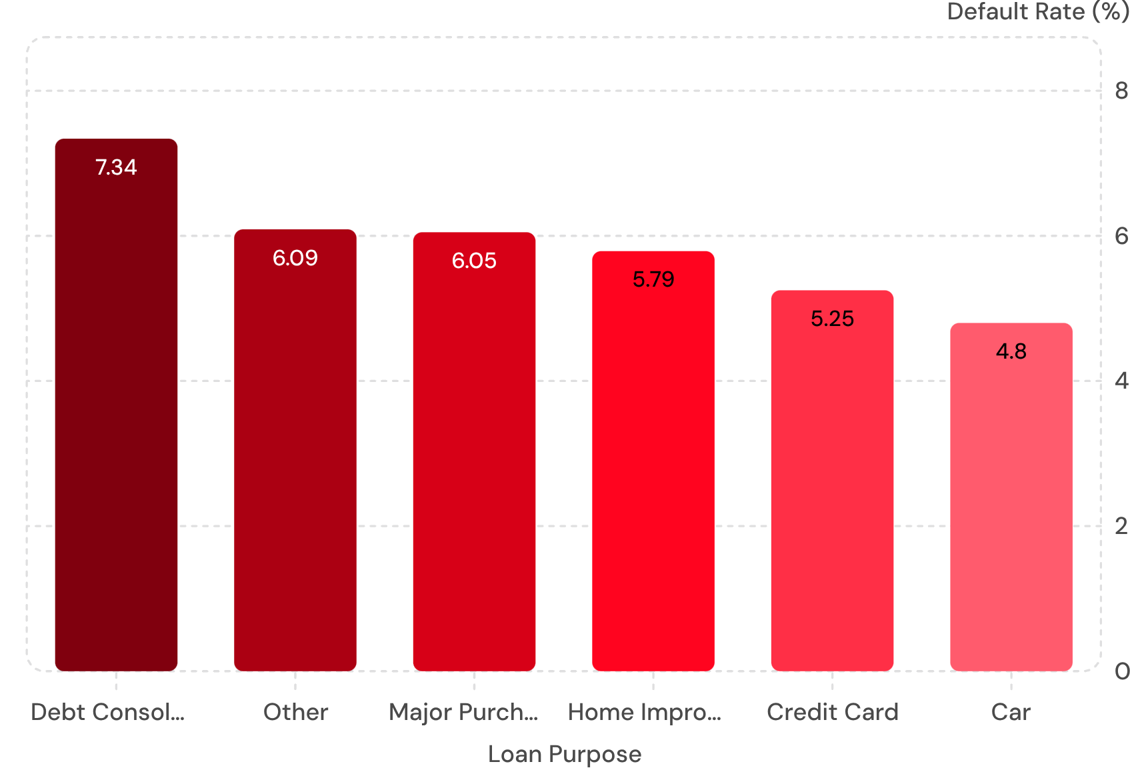
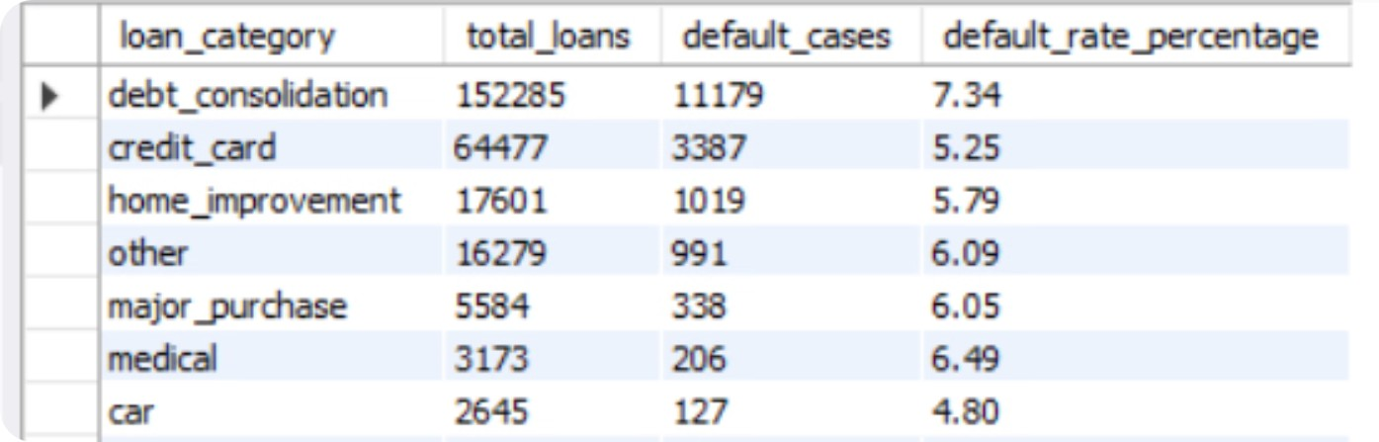

Loan Purpose Popularity & Default Rates
QUESTION 8
SQL Query
Default Rate by Loan Purpose
SELECT purpose AS loan_category,
COUNT(loan_id) AS total_loans,
SUM(CASE WHEN loan_status IN
('Charged Off', 'Default')
THEN 1 ELSE 0 END)
AS default_cases,
ROUND(SUM(CASE WHEN loan_status IN
('Charged Off', 'Default')
THEN 1 ELSE 0 END) * 100.0
/ COUNT(loan_id), 2)
AS default_rate_percentage
FROM loan
GROUP BY purpose
ORDER BY total_loans DESC;
Key Takeaway: Debt consolidation dominates volume (152K loans) but carries a 7.34% default rate — the highest in the portfolio. Car loans, while lower volume, achieve the best default performance at 4.80%, validating asset-backed collateral as a risk mitigant.

Slide 10
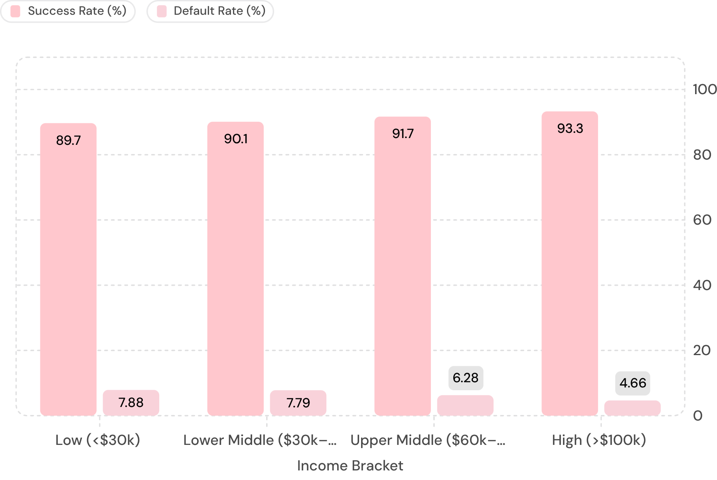
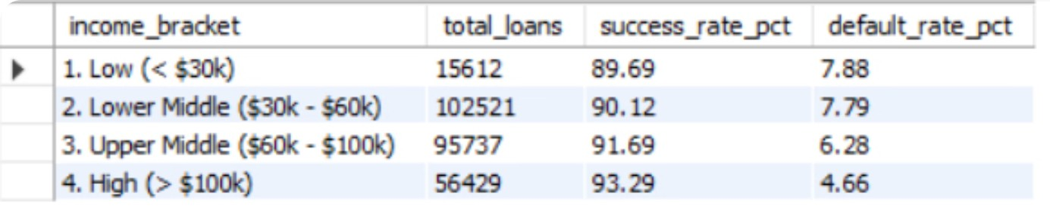
Income Level vs. Loan Success Rate
QUESTION 9
SQL Query (CTE with Income Banding)
Success Rate vs. Default Rate by Income Bracket
SELECT income_bracket,
COUNT(loan_id) AS total_loans,
ROUND(SUM(CASE WHEN loan_status IN
('Fully Paid','Current')
THEN 1 ELSE 0 END)*100.0
/COUNT(loan_id),2)
AS success_rate_pct,
ROUND(SUM(CASE WHEN loan_status IN
('Charged Off','Default')
THEN 1 ELSE 0 END)*100.0
/COUNT(loan_id),2)
AS default_rate_pct
FROM Income_Bands
GROUP BY income_bracket
ORDER BY income_bracket;
WITH Income_Bands AS (
SELECT c.customer_id, l.loan_id,
l.loan_status,
CASE
WHEN c.annual_inc < 30000
THEN '1. Low (< $30k)'
WHEN c.annual_inc BETWEEN
30000 AND 60000
THEN '2. Lower Middle'
WHEN c.annual_inc BETWEEN
60001 AND 100000
THEN '3. Upper Middle'
ELSE '4. High (> $100k)'
END AS income_bracket
FROM customer c
JOIN loan l
ON c.customer_id = l.customer_id
WHERE c.annual_inc IS NOT NULL
)
Key Takeaway: Success rate climbs from 89.69% → 93.29% as income rises, while default rate drops from 7.88% → 4.66% — empirically validating income level as a critical underwriting determinant for credit quality.

Slide 11
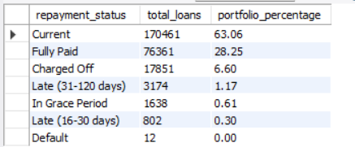

Early Risk Detection — Missed Payment Signals
QUESTION 10
SQL Query
SQL Query Output
SELECT
c.customer_id,
c.addr_state AS state,
l.loan_id,
l.loan_amount,
l.loan_status,
CASE
WHEN l.loan_status = 'Late (16-30 days)' THEN '1 EMI Missed'
WHEN l.loan_status = 'Late (31-120 days)' THEN '2 to 4 EMIs Missed'
WHEN l.loan_status = 'Default' THEN '5+ EMIs Missed'
ELSE 'Unknown'
END AS estimated_missed_payments
FROM customer c
JOIN loan l ON c.customer_id = l.customer_id
WHERE l.loan_status IN ('Late (16-30 days)', 'Late (31-120 days)', 'Default')
ORDER BY l.loan_amount DESC;
🟡 Monitor — Late 1–15 Days
523 borrowers at early stress. Flag in CRM, no action required but trend-watch weekly.
🟠 Escalate — Late 16–30 Days
234 borrowers with 1 EMI missed. Initiate outreach, restructuring options, and payment plans.
🔴 Default Risk — 31+ Days
90 borrowers with multiple missed EMIs. Immediate collections escalation and legal review required.
Key Takeaway: Identifying the 847 at-risk borrowers across tiered delinquency stages enables proactive risk mitigation — catching stress signals early prevents full-default losses and reduces portfolio charge-off exposure.

Slide 12
Thank You!
Thank you for your time and attention. I am open to any questions or feedback.
Contact Information
Email
LinkedIn
GitHub
kumarmohitamu@gmail.com
www.linkedin.com/in/mohitmintorian
https://github.com/MohitMintorian

